Slide 1
Deep Neural Networks
Course 9: Convolutional Neural Networks

Slide 2
Overview
How mammal brain sees the world
Correlation and Convolution
Fourier Transform
Convolutional Neural Networks
Implementation of a Conv Net in Pytorch

Slide 3
How mammal brain sees the world

Slide 4
How mammal brain sees the world
In the early 1950s, David Hubel and Torsten Wiesel performed some experiments on a cat in order to understand how the brain works
Several images with simple shape were slided in front of the cat eyes and activities of a neuron were recorded
You can watch the video here: https://www.youtube.com/watch?v=Cw5PKV9Rj3o

Slide 5
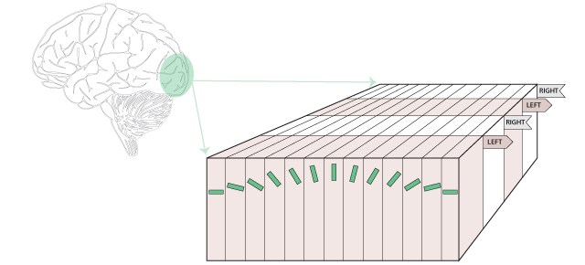
How mammal brain sees the world
They have observed the following:
The visual cortex contains a complex arrangement of cells. These cells are sensitive to small regions of the visual field, called receptive field
The sub regions are tiled to cover the entire visual field
Two basic cells were identified:
Simple: respond to specific edge (orientation and size)
Complex:are invariant to exact position of a pattern

Slide 6
Correlation and Convolution

Slide 7
Correlation and Convolution
Correlation and Convolution are one of the simplest, yet very useful operations that can be performed on images
They are:
Shift-invariant: the output of the convolution is affected by the same amount as each of the inputs
Linear: we replace each pixel of a linear combination of the neighbors
We will look at correlation and convolution as image operators. The images we will test are either 1 dimension (vector) or 2 dimensions (matrix)
Notes:
So if you have pixels with values v1, v2, v3 ... vn
with an average, A = (v1 + v2 + v3 + ... vn) / n,
then if you add some value x to each pixel (i.e. v1 + x, v2 + x, v3 + x ... vn + x),
the new average will simply be A + x.

Slide 8
Correlation and Convolution
Example: local averaging as correlation.
Take an image as input and produce another image
We will average every 3 consecutive numbers:
What about the boundaries?
5 | 4 | 2 | 3 | 7 | 4 | 6 | 5 | 3 | 6
? | $$\frac{5+4+2}{3}$$ | $$\frac{4+2+3}{3}$$ | $$\frac{2+3+7}{3}$$ | $$\frac{3+7+4}{3}$$ | $$\frac{7+4+6}{3}$$ | $$\frac{4+6+5}{3}$$ | $$\frac{6+5+3}{3}$$ | $$\frac{5+3+6}{3}$$ | ?

Slide 9
Correlation and Convolution
Five way to treat the boundaries:
1. Pad with zeros (zeros)
2. Pad with the first and the last values (replicate)
3. Make input circular (circular)
3. Pad input in reflection (reflective)
4. Valid:. Do not apply the operation where there the are missing values. This reduces the output
0 | 0 | 5 | 4 | 2 | 3 | 7 | 4 | 6 | 5 | 3 | 6 | 0 | 0
5 | 5 | 5 | 4 | 2 | 3 | 7 | 4 | 6 | 5 | 3 | 6 | 6 | 6
3 | 6 | 5 | 4 | 2 | 3 | 7 | 4 | 6 | 5 | 3 | 6 | 5 | 4
2 | 4 | 5 | 4 | 2 | 3 | 7 | 4 | 6 | 5 | 3 | 6 | 3 | 5

Slide 10
Correlation and Convolution
Padding is in important since:
It retains the same image size (improves performance)
The information on the borders would be washed away after a few layers.
Using zero padding might produce artifacts in the output image (which some times are desired).
On the other hand, if one needs to upscale an image, other variants of padding should be used.

Slide 11
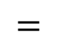
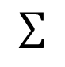
Correlation and Convolution
Example: Same averaging operation, but this time by multiplying with 1/3 and adding the numbers.
5 | 5 | 4 | 2 | 3 | 7 | 4 | 6 | 5 | 3 | 6 | 6
* | * | *
1/3 | 1/3 | 1/3
box filter
$$=$$
5/3 | 4/3 | 2/3
$$∑$$
14/3 | 11/3 | …

Slide 12

Correlation and Convolution
Correlation:
Given a filter $F$ and an image $I$, the correlation of $F$ and $I$ is
$F ∘I(x)=\sum_{i=−N}^{i=N}{F\left(i\right)I(x+i)}$
A box filter would be:
$F\left(i\right)=\left\{\begin{aligned}\frac{1}{3} for i=−1,0,1 \\ 0 , for i≠−1, 0, 1\end{aligned}\right.$

Slide 13
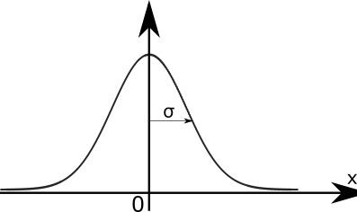

Correlation and Convolution
Other Filters:
Gaussian filter (used for smoothing):
$F\left(i\right)=\frac{G\left(i\right)}{\sum_{−N}^{+N}{G(x)}} for i=−N..N$
where $G\left(x\right)=\frac{1}{σ\sqrt{2π}}\exp\left(−\frac{x^{2}}{2σ^{2}}\right)$
This is actually an approximation of the Gaussian filter, since a true Gaussian would be computed on all of the elements of the image.
Notes:
$=\frac{\sum_{−N}^{+N}{G(x)}}{\sum_{−∞}^{+∞}{G(x)}}$ Normal asta ar fi filtru Gaussian. Problema e ca asta merge la infinut, dar putem luat doa ro parte din elemente, intrucat dupa o buna parte G(x) este zero. Problema e ca daca aproximam elementele, media nu mai da 1. Iar asta inseamna de fapt ca renuntam la o aprte din informative. (adica facem imaginea mai alba). Solutia este sa aproximam doar pe o anumita zona

Slide 14

Correlation and Convolution
Correlation is mainly used in order to find portions of an image that are similar to the filter.
Correlation can be viewed as dot product of two vectors in Euclidian space
$$F∘I\left(x\right)=\left|\left|F\right|\right|\left|\left|I_{x}\right|\right|cos⁡θ$$
For $F$ and $I_{x}$ of fixed magnitudes, the values is the greatest when $θ=0$. $I$ is a scaled vector of $F$.

Slide 15

Correlation and Convolution
Correlation in 2d:
$$F ∘I(x,y)=\sum_{j=−N}^{j=N}{\sum_{i=−N}^{i=N}{F\left(i,j\right)I(x+i,y+j)}}$$
For an image, we compute the correlation by aligning the filter with the image and sliding the filter

Slide 16
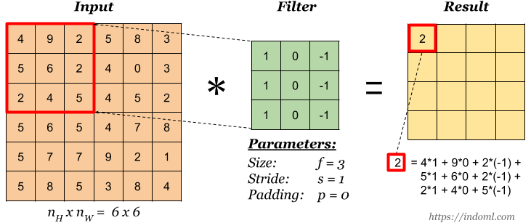
Correlation and Convolution
Cross-Correlation Operation:
Images from https://indoml.com/2018/03/07/student-notes-convolutional-neural-networks-cnn-introduction/

Slide 17
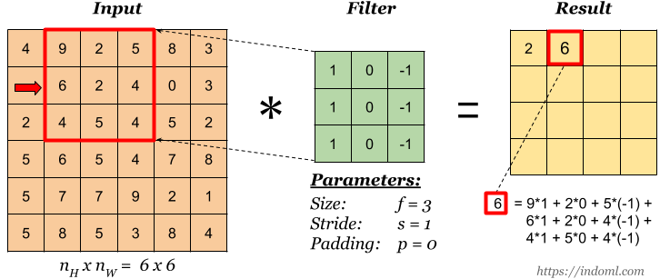
Correlation and Convolution
Cross-Correlation Operation:
Images from https://indoml.com/2018/03/07/student-notes-convolutional-neural-networks-cnn-introduction/

Slide 18
Correlation and Convolution
Cross-Correlation Operation:
 |  | -4 | 5
0 | 4 | 0 | -1
-5 | 0 | 3 | 6
-2 | 5 | 0 | 3
Images from https://indoml.com/2018/03/07/student-notes-convolutional-neural-networks-cnn-introduction/

Slide 19

Correlation and Convolution
Convolution
Convolution is the same as correlation but we flip the filter horizontally and vertically
$$F∗I\left(x\right)=\sum_{i=−N}^{i=N}{F\left(i\right)I(x−i)}$$
$$F∗I\left(x,y\right)=\sum_{j=−N}^{j=N}{\sum_{i=−N}^{i=N}{F\left(i,j\right)I(x−i,x−j)}}$$
If the filter is symmetric ,both correlation and convolution output the same value

Slide 20
Convolution operation in NN
Convolutional Operation:
Flipping the kernel:
With the resulted kernel, perform the cross-correlation operation
1 | 2 | 3
4 | 5 | 6
7 | 8 | 9
7 | 8 | 9
4 | 5 | 6
1 | 2 | 3
9 | 8 | 7
6 | 5 | 4
3 | 2 | 1
Flip rows
Flip columns
Images from https://indoml.com/2018/03/07/student-notes-convolutional-neural-networks-cnn-introduction/

Slide 21
Convolution operation in NN
Convolution Operation:
Flipped Filter
-1 | 0 | 1
-1 | 0 | 1
-1 | 0 | 1
Images from https://indoml.com/2018/03/07/student-notes-convolutional-neural-networks-cnn-introduction/

Slide 22
Convolution operation in NN
Convolution Operation:
Flipped Filter
Result
-2 | -6 | 4 | -5
0 | -4 | 0 | 1
5 | 0 | -3 | -6
2 | -5 | 0 | -3
-1 | 0 | 1
-1 | 0 | 1
-1 | 0 | 1
=
Images from https://indoml.com/2018/03/07/student-notes-convolutional-neural-networks-cnn-introduction/

Slide 23
Correlation and Convolution
Convolution
The advantage of convolution is that it is associative. Correlation is not.
For example, we want to smooth an image and find it’s average.
With correlation we have to do two correlation operations.
With convolution a single operation is needed using a convolved Gaussian filter by an average one.
Convolution Is usually for image processing (smoothing) while correlation is used to match a template
Notes:
Puteti testa folosind filter F=G=(-1,0,1)
Nu prea are sens sa faci match la doua tempalteuri.

Slide 24
Correlation and Convolution
Convolution
Until now we’ve used convolution/correlation in order to modify an image.
In order to understand why convolution/correlation is very powerfull when used in neural network, we must look at the Convolution Theorem
Notes:
Puteti testa folosind filter F=G=(-1,0,1)
Nu prea are sens sa faci match la doua tempalteuri.

Slide 25
Convolution Theorem

Slide 26
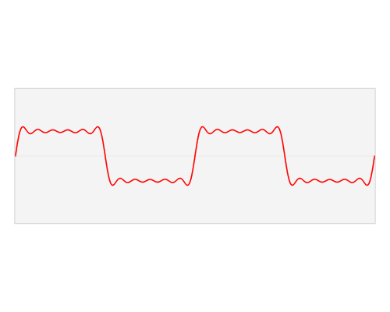
Convolution Theorem
Fast Fourier Transform:
The Fast Fourier transform algorithm transforms an original function in a sum of wave-like cosine and sine terms.
Images from https://en.wikipedia.org/wiki/Frequency_domain
Notes:
Un cantec interretat de o orchestra are mai multe instrumente. Fieacre instrument are o anumita frecventa pe care reusim sa o interpretam.

Slide 27
Convolution Theorem
Fast Fourier Transform:
This makes it easy to understand for sounds. It transforms the function from time-domain to frequency domain.
Example: a song played by an orchestra
An equalizer is a filter that affects only some frequencies.
Notes:
Un cantec interretat de o orchestra are mai multe instrumente. Fieacre instrument are o anumita frecventa pe care reusim sa o interpretam.
Time-domain: aplitudine pe y si timp pe axa

Slide 28

Convolution Theorem
Fast Fourier Transform:
Every function can be transformed into Fourier domain.
An image can be viewed as a Function $f\left(x,y\right).$ Each pixel has a value outputted by the function, given its coordinates. This is the spatial domain.
Transforming the image into Fourier space basically means breaking down into different frequencies:
Low frequencies correspond to smooth, gradual changes in intensity (large uniform areas)
High frequencies correspond to rapid changes in intensity (ex: edges, fine details, noise)

Slide 29
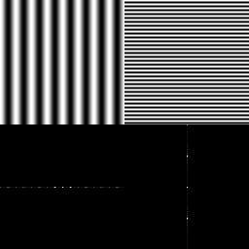
Convolution Theorem
Fourier Transforms.
Images in Fourier space:
There is an axis that runs horizontally and
One vertically. These tell how frequencies
vary horizontally or vertically
The center of the image is (0,0) frequency
Images from https://www.cs.unm.edu/~brayer/vision/fourier.html
Notes:
Orice frecventa are o faza si o amplitudine.
Un graphic fourier ne arata frecventele.
Spre centru vedem frecventele mici, iar spre margini vedem frecventele mari.
Pe axa x vedem frecventele pe axa x a imaginii, iar pe axa y vedem frecventele pe axa y

Slide 30
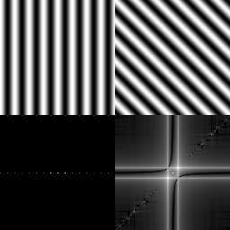
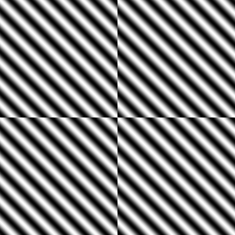
Convolution Theorem
Fourier Transforms.
When an image is rotated, its Fourier Transform is also rotated (image a)
The Fourier Transform treats an image as it is part of a periodically replicated array of identical images extended to infinity (image b)
Images from https://www.cs.unm.edu/~brayer/vision/fourier.html

Slide 31
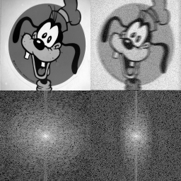
Convolution Theorem
Fourier Transforms.
Most images will have a white blob at the center. This is because in an image, most of the transitions are slow (low frequencies)
The image on the right has been smoothed only on the horizontal. Notice how high frequencies have been attenuated
Images from https://www.cs.unm.edu/~brayer/vision/fourier.html

Slide 32
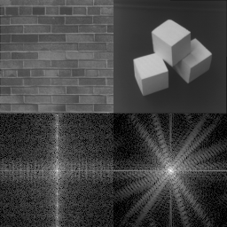
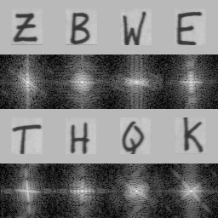
Convolution Theorem
A line must be represented by a high frequency pattern.
In the Fourier Transform a strong edge results into a line going to a high frequency perpendicular to the edge. Circular segments are also circular in FT
Images from https://www.cs.unm.edu/~brayer/vision/fourier.html

Slide 33

Convolution Theorem
For a 2 dimensional, discrete function and kernel, the convolutional Theorem is:
$$feature map=input∗kernel=$$
$$=\sum_{y=0}^{columns}{\sum_{x=0}^{rows}{input\left(x−a,y−b\right)kernel\left(x,y\right)=F^{−1}\left(\sqrt{2π}F\left[input\right]F\left[kernel\right]\right)}}$$
$$F is Fourier Transform \\ F^{−1} is inverse Fourier Transform$$
A convolution is equivalent to a multiplication in the Fourier space

Slide 34
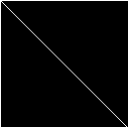

Convolution Theorem
This makes filtering in Fourier space very easy.
As seen earlier the Fourier transform maintains important information from the original image. I.e. it retains the orientation of an edge.
In order to extract only certain information from an image (i.e. edge), we can create a filter that when transformed in Fourier space contains the Fourier transform of the edge and zeros
Line in spatial domain
Line in Fourier domain
Images from https://www.cs.unm.edu/~brayer/vision/fourier.html

Slide 35
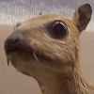
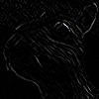
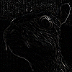

Correlation and Convolution: kernels
Edge detection
0 | 0 | 0
0 | 1 | 0
0 | 0 | 0
1 | 0 | -1
0 | 1 | 0
-1 | 0 | 1
0 | 1 | 0
1 | -4 | 1
0 | 1 | 0
-1 | -1 | -1
-1 | 8 | -1
-1 | -1 | -1
Images from https://en.wikipedia.org/wiki/Kernel_(image_processing)

Slide 36
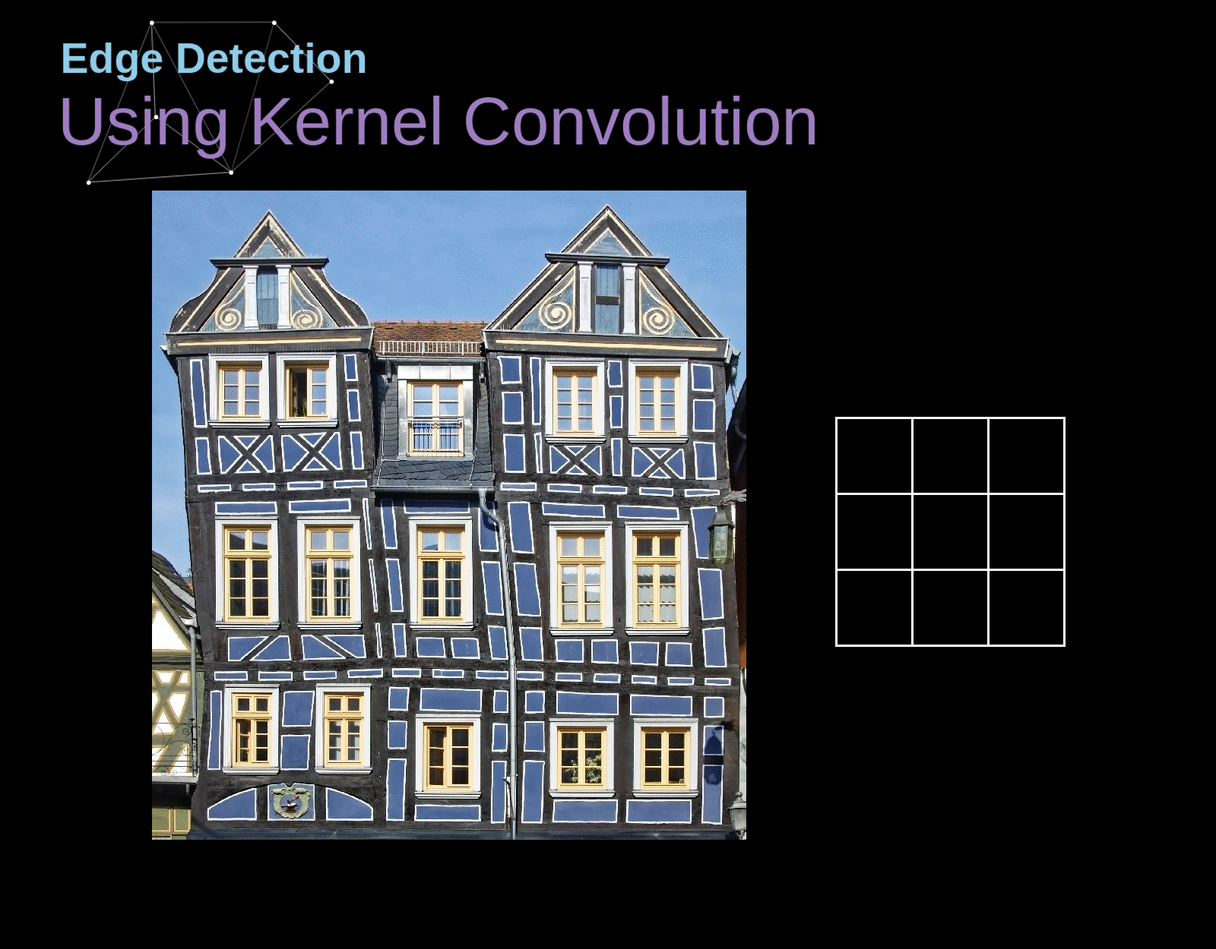
Convolution operation in NN
Kernels can be used to transform the image in a format that is easier to process.
https://towardsdatascience.com/gentle-dive-into-math-behind-convolutional-neural-networks-79a07dd44cf9

Slide 37
Correlation and Convolution: kernels
Convolution or Correlation can be viewed as a way of feature engineering.
Feature engineering is one of the most important things in machine learning, but is also difficult.
We would like to use neural networks to create features
Convolutional Neural Networks are based on correlation (even though this can be seen as convolution with a flipped filter)

Slide 38
Convolution Neural Network

Slide 39
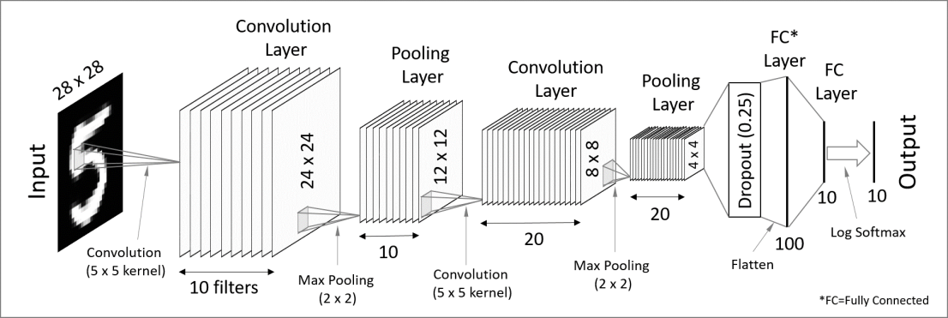
Convolutional Neural Network: architecture
A convolutional neural network is made of several layers of the following type:
Convolutional layer + nonlinearity (relu)
Maxpooling
Fully connected layers
Image source: https://codetolight.wordpress.com/2017/11/29/getting-started-with-pytorch-for-deep-learning-part-3-neural-network-basics/

Slide 40
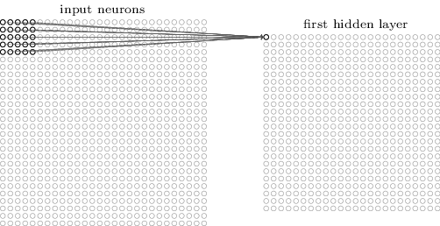
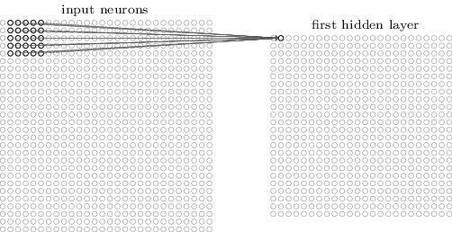
Convolutional Neural Network: architecture
The first layer is a convolutional layer. It is obtained by convolving a kernel (represented by a set of shared weights) over the input
Each neuron from the first convolutional layer is connected to only a subset of the input (called receptive field)
All the neurons in the hidden layer are connected to their receptive field using the same weights (shared weights)

Slide 41

Convolution operation in NN
Output size:
$$R_{h}×R_{W}$$
$$F_{h}×F_{W}$$
$$H×W$$
Filter
Result
$$R_{h}=H−F_{h}+1$$
$$R_{w}=W−F_{w}+1$$
Input

Slide 42
Convolutional Neural Network: architecture
Convolutional operations have several advantages:
Translation Invariance: they are able to detect patterns like edges, corners, textures regardless where they appear in the input
It is not dependent on the image size.
The number of parameters are reduced drastically
Example:
an input of 28x28 with a kernel of 5x5 requires 25 weights . This results in an output of 24x24 pixels
A fully connected layer with the same output would require: 24x24x28x28 = 451584 weights
This allows as to have deeper networks with multiple kernels

Slide 43
Convolutional Neural Network: architecture
Convolutional operation is differentiable
The kernels, which represent the weights of the convolutional layer are learnt automatically by the network
They are randomly initialized
They are adjusted, like standard weights, due to the backpropagation algorithm.
The convolution layers work because of the Convolution Theorem. Even if we implement them as Correlations (so no flipping is happening), since they are learnt, we can consider the network learns the flipped kernel.

Slide 44
Correlation and Convolution
Edge detection using correlation. Observe that the highest values in the output are where the filter matches the input.
-1 | -1 | -1 | -1 | -1 | -1 | -1 | -1 | -1
-1 | 1 | -1 | -1 | -1 | -1 | -1 | 1 | -1
-1 | -1 | 1 | -1 | -1 | -1 | 1 | -1 | -1
-1 | -1 | -1 | 1 | -1 | 1 | -1 | -1 | -1
-1 | -1 | -1 | -1 | 1 | -1 | -1 | -1 | -1
-1 | -1 | -1 | 1 | -1 | 1 | -1 | -1 | -1
-1 | -1 | 1 | -1 | -1 | -1 | 1 | -1 | -1
-1 | 1 | -1 | -1 | -1 | -1 | -1 | 1 | -1
-1 | -1 | -1 | -1 | -1 | -1 | -1 | -1 | -1
5 | -3 | -1 | 1 | 3 | -3 | 1
-3 | 7 | -3 | 1 | -3 | 3 | -3
3 | -3 | 7 | -5 | 3 | -3 | 3
1 | 5 | -5 | 7 | -5 | 1 | 1
3 | -3 | 3 | -5 | 7 | -3 | -1
-3 | 3 | -3 | 5 | -3 | 7 | -3
3 | -3 | 3 | 1 | 3 | -3 | 7
1 | -1 | -1
-1 | 1 | -1
-1 | -1 | 1
Notes:
Valorile maxime sunt date de cele care respecta filtrul

Slide 45
Correlation and Convolution
Edge detection using correlation. Observe that the highest values in the output are where the filter matches the input.
-1 | -1 | -1 | -1 | -1 | -1 | -1 | -1 | -1
-1 | -1 | 1 | 1 | 1 | 1 | 1 | -1 | -1
-1 | -1 | 1 | -1 | -1 | -1 | 1 | -1 | -1
-1 | -1 | -1 | -1 | -1 | 1 | -1 | -1 | -1
-1 | -1 | -1 | -1 | 1 | -1 | -1 | -1 | -1
-1 | -1 | -1 | 1 | -1 | -1 | -1 | -1 | -1
-1 | -1 | 1 | -1 | -1 | -1 | -1 | -1 | -1
-1 | -1 | 1 | 1 | 1 | 1 | 1 | -1 | -1
-1 | -1 | -1 | -1 | -1 | -1 | -1 | -1 | -1
5 | -3 | -1 | 1 | 3 | -3 | 1
-3 | 7 | -3 | 1 | -3 | 3 | -3
3 | -3 | 7 | -5 | 3 | -3 | 3
1 | 5 | -5 | 7 | -5 | 1 | 1
3 | -3 | 3 | -5 | 7 | -3 | -1
-3 | 3 | -3 | 5 | -3 | 7 | -3
3 | -3 | 3 | 1 | 3 | -3 | 7
-1 | -1 | 1
-1 | 1 | -1
1 | -1 | -1
Notes:
Valorile maxime sunt date de cele care respecta filtrul

Slide 46
Correlation and Convolution
Edge detection using correlation. Observe that the highest values in the output are where the filter matches the input.
-1 | -1 | -1 | -1 | -1 | -1 | -1 | -1 | -1
-1 | 1 | -1 | -1 | -1 | -1 | -1 | 1 | -1
-1 | -1 | 1 | -1 | -1 | -1 | 1 | -1 | -1
-1 | -1 | -1 | 1 | -1 | 1 | -1 | -1 | -1
-1 | -1 | -1 | -1 | 1 | -1 | -1 | -1 | -1
-1 | -1 | -1 | 1 | -1 | 1 | -1 | -1 | -1
-1 | -1 | 1 | -1 | -1 | -1 | 1 | -1 | -1
-1 | 1 | -1 | -1 | -1 | -1 | -1 | 1 | -1
-1 | -1 | -1 | -1 | -1 | -1 | -1 | -1 | -1
3 | -5 | 1 | -1 | 1 | -5 | 3
-5 | 5 | -5 | 3 | -5 | 5 | -5
1 | -5 | 5 | -7 | 5 | -5 | 1
-1 | 3 | -7 | 9 | -7 | 3 | -1
1 | -5 | 5 | -7 | 5 | -5 | 1
-5 | 5 | -5 | 3 | -5 | 5 | -5
5 | -5 | 1 | -1 | 1 | -5 | 5
1 | -1 | 1
-1 | 1 | -1
1 | -1 | 1
Notes:
Valorile maxime sunt date de cele care respecta filtrul

Slide 47

Convolution operation in NN
Output size:
Many times, we want to preserve spatial dimensions. Especially on deep neural network. For this we add padding:
Pytorch supports all padding previously discussed:
Zero
Replicate
Circular
Reflective
Images from: Vincent Dumoulin, Francesco Visin - A guide to convolution arithmetic for deep learning

Slide 48

Convolution operation in NN
Output size:
The amount of padding needed to preserve input dimensions:
$P=\frac{F−1}{2}$
Where:
$F$ is the filter size. Assuming ($F_{w}=F_{h})$
$P$ is the amount of padding added on all sides (top, bottom, left, right
Images from: Vincent Dumoulin, Francesco Visin - A guide to convolution arithmetic for deep learning

Slide 49

Convolution operation in NN
Strided convolutions:
Many times, we want to down sample to be able to reduce computation cost.
Strided convolutions:
The filter moves across the input with steps larger than 1.
In a traditional convolution, stride S=1
Images from: Vincent Dumoulin, Francesco Visin - A guide to convolution arithmetic for deep learning

Slide 50

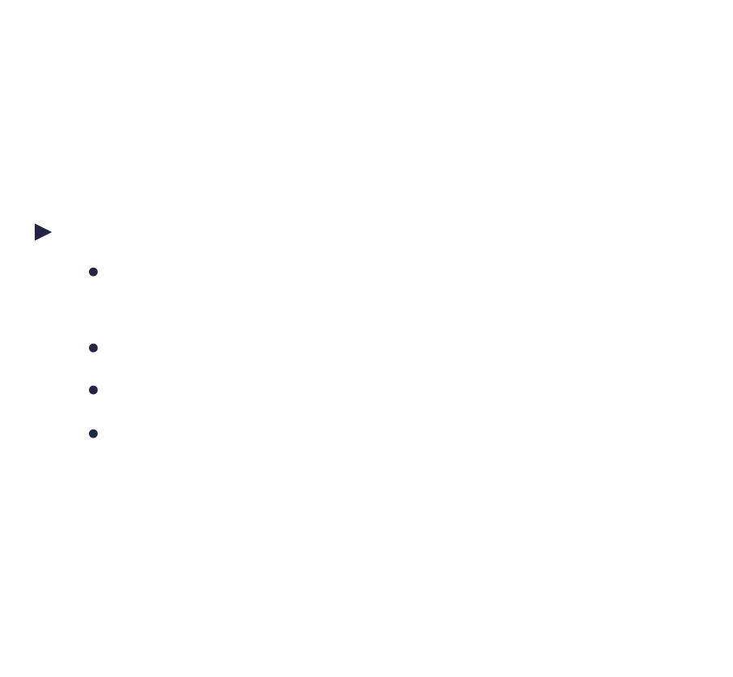
Convolution operation in NN
Strided convolutions:
$W=\frac{W_{in}−F_{w}+2P}{s}+1$
Where:
$W_{in}$ is the input size. Assuming a square input
$F_{w}$ is the filter width.
$P$ is the amount of padding
$S$ is the stride. How many pixels we move the filter, horizontally and vertically
Images from: Vincent Dumoulin, Francesco Visin - A guide to convolution arithmetic for deep learning

Slide 51
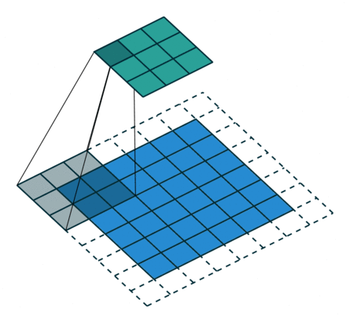

Convolution operation in NN
Strided convolutions:
OBS: If S!=1, then the size of the output might not be an integer number.
$$W=\frac{W_{in}−F_{w}+2P}{s}+1$$
Example: if input =32, F=3, P =1, S = 2, the output would be:
$W=\frac{32−3+2∗1}{2}+1=\frac{31}{2}+1=4.$
Images from: Vincent Dumoulin, Francesco Visin - A guide to convolution arithmetic for deep learning
Notes:
Pytorch face floor cand n se potriveste size-ul

Slide 52
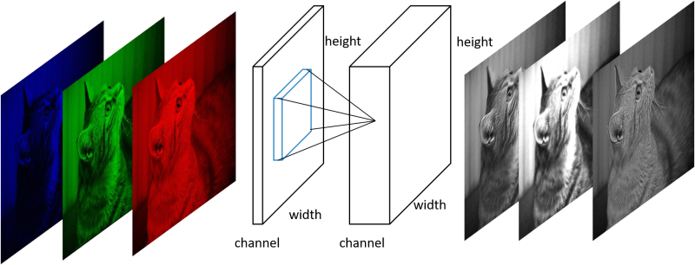
Convolutional Neural Network: architecture
If the image has more than two dimensions (i.e. RGB) the convolution must be performed on each channel separately and the results added.
Image from http://corochann.com

Slide 53
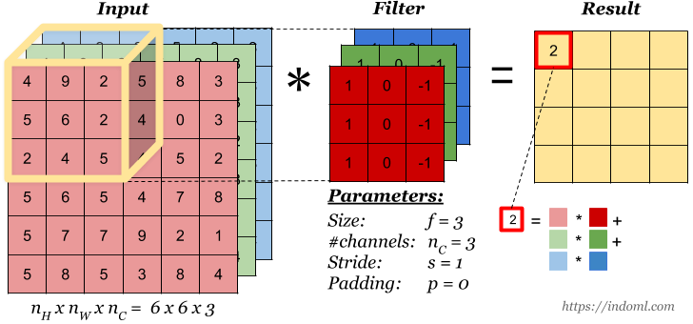
Convolution operation in NN
The filter must have the same number of channels as the input
Images from https://indoml.com/2018/03/07/student-notes-convolutional-neural-networks-cnn-introduction/

Slide 54
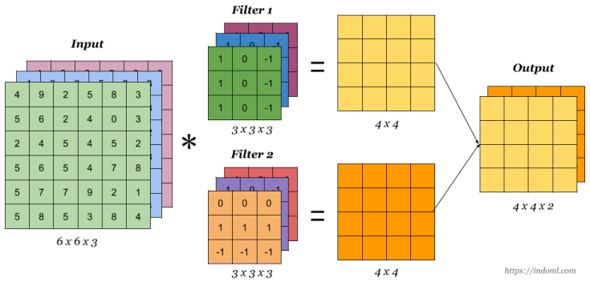
Convolution operation in NN
Images from https://indoml.com/2018/03/07/student-notes-convolutional-neural-networks-cnn-introduction/

Slide 55
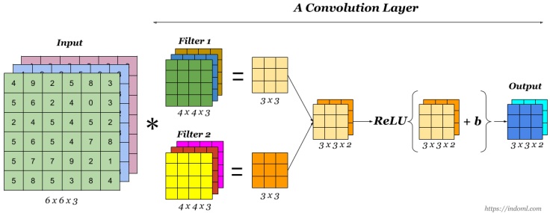
Convolution operation in NN
Finally to make up a convolution layer, a bias (ϵ R) is added and an activation function such as ReLU
Images from https://indoml.com/2018/03/07/student-notes-convolutional-neural-networks-cnn-introduction/

Slide 56
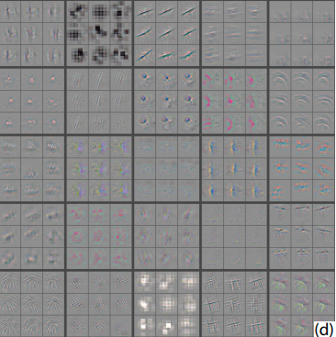
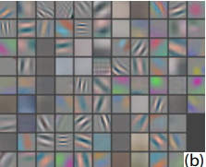
Correlation and Convolution
Visualization of first and second layer of features from AlexNet
Notes:
Valorile maxime sunt date de cele care respecta filtrul

Slide 57

Convolutional Neural Network: architecture
Followed by the convolutional layer is usually a pooling layer
The purpose of pooling is to reduce the size of the output (less parameters)➔ reduce overfitting
The pooling works independently on every Map. Thus there will be as many pooling maps as there are convolutional maps.
Pooling is also called downsampling
Image from http://cs231n.github.io/convolutional-networks/

Slide 58
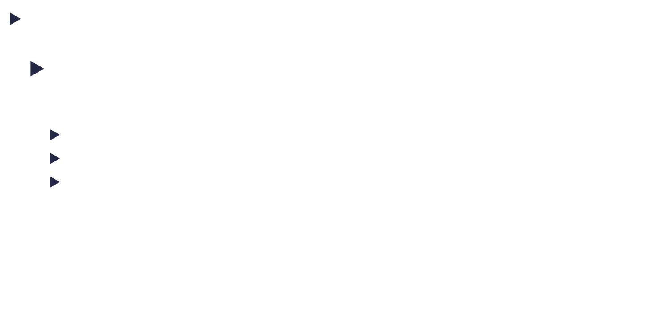
Convolutional Neural Network: architecture
Pooling
Pooling is also applied using a receptive field. So each pooling unit connects to only a small part of the input. Thus a pooling is defined by:
The pooling function
Stride (S)
Their spatial extent (F)
The number of pooling units in each pooling slice will be:
$$n_{out}=\frac{n_{in}−F}{S}+1$$

Slide 59

Convolutional Neural Network: architecture
Pooling
Although there are many pooling functions (L2 pooling, Average Pooling) the most used one is max-pooling.
In practice there are two variations of max pooling used:
F=2 and S=2
F=3 and S=2, also called overlapping pooling
Image from http://cs231n.github.io/convolutional-networks/
Notes:
Pooling mai mari de 2x2 sunt considerate prea destructive
Unele retele considera ca pooling-ul este prea destructive, asa ca incearca sa scape de el
O solutie ar fi sa folosesti un stide mai mare in sstratul de convolutie, din cand in cand.
Scaparea de pooling s-a observant a fi importanta si in modele generative, asa cum este vairational autoencoder

Slide 60
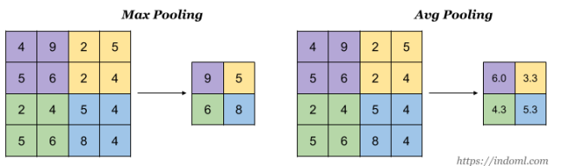
Convolutional Neural Network: architecture
Pooling
Although there are many pooling functions (L2 pooling, Average Pooling) the most used one is max-pooling.
In practice there are two variations of max pooling used:
F=2 and S=2
F=3 and S=2, also called overlapping pooling
Image source: https://indoml.com/2018/03/07/student-notes-convolutional-neural-networks-cnn-introduction/
Notes:
Pooling mai mari de 2x2 sunt considerate prea destructive
Unele retele considera ca pooling-ul este prea destructive, asa ca incearca sa scape de el
O solutie ar fi sa folosesti un stide mai mare in sstratul de convolutie, din cand in cand.
Scaparea de pooling s-a observant a fi importanta si in modele generative, asa cum este vairational autoencoder

Slide 61
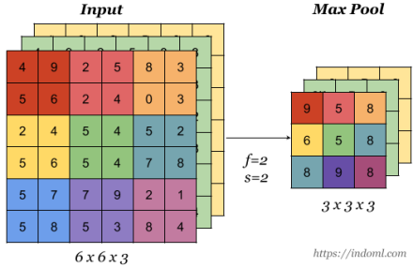
Convolutional Neural Network: architecture
Pooling
After the pooling layer, the number of channels remains unchanged, but the width and height will be changed.
Image source: https://indoml.com/2018/03/07/student-notes-convolutional-neural-networks-cnn-introduction/
Notes:
Pooling mai mari de 2x2 sunt considerate prea destructive
Unele retele considera ca pooling-ul este prea destructive, asa ca incearca sa scape de el
O solutie ar fi sa folosesti un stide mai mare in sstratul de convolutie, din cand in cand.
Scaparea de pooling s-a observant a fi importanta si in modele generative, asa cum este vairational autoencoder

Slide 62
Convolutional Neural Network: architecture
The fully connected layer are usually used last and their purpose is to exploit the features created by the convolutional + pooling layers before
The fully connected layers are standard layers of neurons that usually use RELU as activation function

Slide 63
Convolutional Neural Network: architecture
Common architectures:
The most common convolutional neural networks connect the input to a stack of convolutional layers with relu activations followed by maxpooling.
After the input has been sufficiently reduced, the classification part is carried by the fully connected layers.
To denote architectures, the following notation will be used:
Conv = convolutional layer
Relu = relu activation
FC = Fully connected
Pool = pooling (usually max-pooling)
Input = input image

Slide 64

Convolutional Neural Network: architecture
Common architectures:
So a general architecture could be defined by:
Input→[[Conv -> Relu]*N → Pool]*M → [FC → Relu]*K → FC
Where
$N∈[0,3]$
$M>0$
$K∈[0,3]$

Slide 65
Convolutional Neural Network: architecture
Common architectures:
Input→FC→Relu→FC (MLP with relu activation)
Input→Conv→Relu→FC
Input→[Conv→Relu→Pool]*2→FC→Relu→FC (each convolutional layer is followed by a pooling layer)
Input →[Conv→Relu→Conv→Relu→Pool]*3→[FC→Relu]*2→FC (here, pooling is used after a set of 2 convolutional layers. This is done in order to obtain better features, before applying downsampling

Slide 66
Convolutional Neural Network: architecture
Recommendations:
Use small filters and many layers rather than large filters
Suppose we have the following architecture in the convolutional part of the network Conv→Relu→Conv→Relu→Conv→Relu
The filter size is 3 and the stride is 1.
In this case, The first convolutional layer looks at 3x3 of the input, the second at 5x5 while the third 7x7
This is better than a single convolutional layer of 7x7
Notes:
E posibil ca respectand recomandarile, sa ocupi f multa memorie.
Daca nu poti altfel, redu input-ul la inceput folosind stride2 si f=7x7

Slide 67
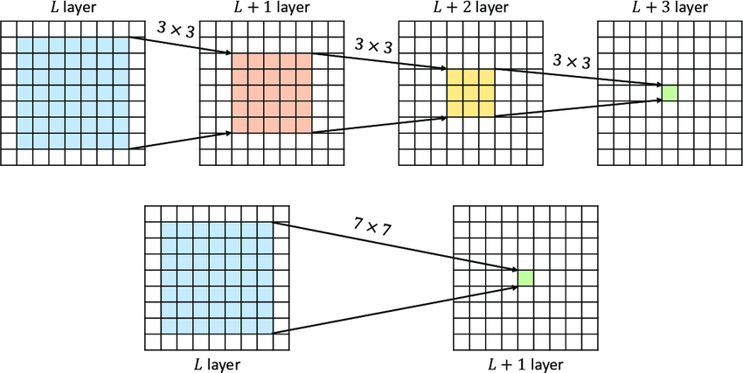
Convolutional Neural Network: architecture
Recommendations:
In this case, The first convolutional layer looks at 3x3 of the input, the second at 5x5 while the third 7x7
Source: Dong, Zhiang & Xie, Miao & Li, Xiaoqiang. (2023). Multi-Scale Receptive Fields Convolutional Network for Action Recognition. Applied Sciences. 13. 3403. 10.3390/app13063403.
Notes:
E posibil ca respectand recomandarile, sa ocupi f multa memorie.
Daca nu poti altfel, redu input-ul la inceput folosind stride2 si f=7x7

Slide 68

Convolutional Neural Network: architecture
Recommendations:
3 layers with non-linearity express better features than 1 linear layer
Less parameters:
If the input has C channels and the output has C filters:
3 layers of 3x3 filter and depth of C would require
$3∗\left(3^{2}∗C^{2}\right)=27C^{2}$ parameters
A layer of 7x7 filter would require $7∗7∗C^{2}=49C^{2}$ parameters
Notes:
E posibil ca respectand recomandarile, sa ocupi f multa memorie.
Daca nu poti altfel, redu input-ul la inceput folosind stride2 si f=7x7

Slide 69
Convolutional Neural Network: architecture
Recommendations:
Prefer small filters over large ones (i.e. 3x3, 5x5)
Retain the input size in the convolutional layers and let pooling do the down sampling. (use stride of 1 and padding)
Keep pooling to 2x2 or 3x3 and stride 2. Larger pooling are too destructive
Use Padding (in order not to lose information from the edges)
Compromise only on the first layer(i.e. 7x7 and stride 2)
Notes:
E posibil ca respectand recomandarile, sa ocupi f multa memorie.
Daca nu poti altfel, redu input-ul la inceput folosind stride2 si f=7x7

Slide 70
Convolutional Neural Networks
Parameters
in_channels (int) – Number of channels in the input image
out_channels (int) – Number of channels produced by the convolution
kernel_size (int or tuple) – Size of the convolving kernel
stride (int or tuple, optional) – Stride of the convolution. Default: 1
padding (int, tuple or str, optional) – Padding added to all four sides of the input. Default: 0
dilation (int or tuple, optional) – Spacing between kernel elements. Default: 1
groups (int, optional) – Number of blocked connections from input channels to output channels. Default: 1
bias (bool, optional) – If True, adds a learnable bias to the output. Default: True
padding_mode (str, optional) – 'zeros', 'reflect', 'replicate' or 'circular'. Default: 'zeros'

Slide 71
Convolutional Neural Networks
Parameters
kernel_size (Union[int, Tuple[int, int]]) – the size of the window to take a max over
stride (Union[int, Tuple[int, int]]) – the stride of the window. Default value is kernel_size
padding (Union[int, Tuple[int, int]]) – Implicit negative infinity padding to be added on both sides
dilation (Union[int, Tuple[int, int]]) – a parameter that controls the stride of elements in the window
return_indices (bool) – if True, will return the max indices along with the outputs. Useful for torch.nn.MaxUnpool2d later
ceil_mode (bool) – when True, will use ceil instead of floor to compute the output shape

Slide 72
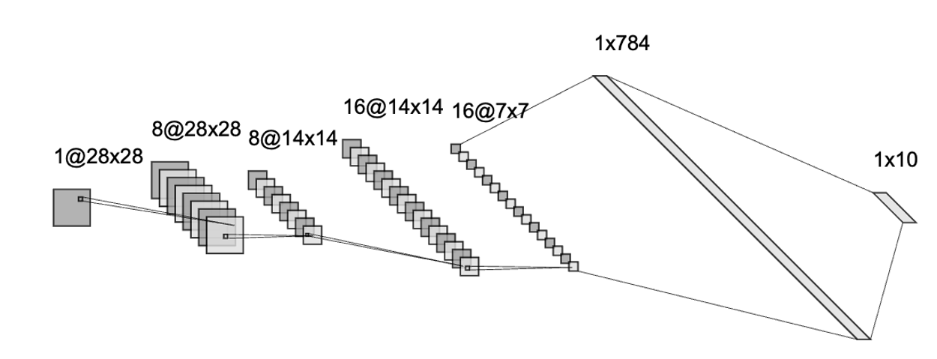
Convolutional Neural Network: implementation
Implement MNIST classification using using convolutional neural network
Conv 3x3. MaxPooling 2x2 Conv 3x3 MaxPooling 2x2 Reshape.

Slide 73
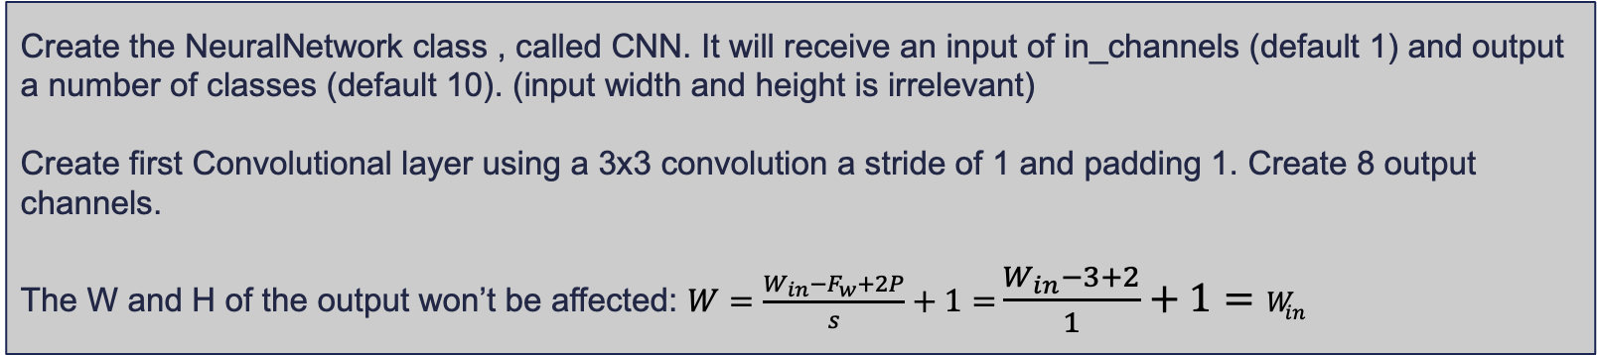
Convolutional Neural Networks
class CNN(nn.Module):
def __init__(self, in_channels=1, num_classes=10):
super(CNN, self).__init__()
self.conv1 = nn.Conv2d(
in_channels=in_channels,
out_channels=8,
kernel_size=3,
stride=1,
padding=1,
)
Create the NeuralNetwork class , called CNN. It will receive an input of in_channels (default 1) and output a number of classes (default 10). (input width and height is irrelevant)
Create first Convolutional layer using a 3x3 convolution a stride of 1 and padding 1. Create 8 output channels.
The W and H of the output won’t be affected: $W=\frac{W_{in}−F_{w}+2P}{s}+1=$ $\frac{W_{in}−3+2}{1}+1=W_{in}$

Slide 74
Convolutional Neural Networks
class CNN(nn.Module):
def __init__(self, in_channels=1, num_classes=10):
. . .
self.pool = nn.MaxPool2d(kernel_size=2, stride=2)
self.conv2 = nn.Conv2d(
in_channels=8,
out_channels=16,
kernel_size=3,
stride=1,
padding=1,
)
self.fc1 = nn.Linear(16 * 7 * 7, num_classes)
Create the rest of the layers needed MaxPooling: 2x2 with stride 2. Since maxpooling doesn’t have parameters we can initialize just one
Another Conv2 layer, similar to previous, but with 16 nr of output channels.
A fully connected layer. The input size is computed as such: 28 /2(1st maxpooling)=14, 14/2 (2nd maxpooling)=7. So 7x7 x 16 output channels

Slide 75
Convolutional Neural Networks
class CNN(nn.Module):
. . .
def forward(self, x):
x = F.relu(self.conv1(x))
x = self.pool(x)
x = F.relu(self.conv2(x))
x = self.pool(x)
x = x.reshape(x.shape[0], -1)
x = self.fc1(x)
return x
Implement the forward method:
Call the layers in order:
1st convolutional layer followed by relu activation
Use maxpooling
2nd convolutional layer followed by relu activation
Reshape (c,w,h) to 1d . Keep batch size
Apply fully-connected layer that outputs the classes

Slide 76
Convolutional Neural Network: implementation
Training a simple Convolutional Neural Network on mnist dataset. The rest of the code is the same as in a classical neural network. Just need to remove the reshape(x.shape[0],-1)
100%|█████████████████████████████████████████████████| 938/938 [00:08<00:00, 113.48it/s]
100%|█████████████████████████████████████████████████| 938/938 [00:09<00:00, 102.39it/s]
100%|█████████████████████████████████████████████████| 938/938 [00:08<00:00, 107.37it/s]
100%|█████████████████████████████████████████████████| 938/938 [00:08<00:00, 115.21it/s]
100%|█████████████████████████████████████████████████| 938/938 [00:08<00:00, 111.51it/s]
100%|█████████████████████████████████████████████████| 938/938 [00:08<00:00, 116.38it/s]
100%|█████████████████████████████████████████████████| 938/938 [00:08<00:00, 115.38it/s]
100%|█████████████████████████████████████████████████| 938/938 [00:08<00:00, 117.01it/s]
100%|█████████████████████████████████████████████████| 938/938 [00:08<00:00, 111.25it/s]
100%|█████████████████████████████████████████████████| 938/938 [00:08<00:00, 111.64it/s]
Accuracy on training set: 98.17
Accuracy on test set: 98.25

Slide 77
Questions & Discussion
https://www.youtube.com/watch?v=FwFduRA_L6Q (demo of LeNet1 , first Convolutional Neural Network )

Slide 78
Bibliography
http://cs231n.github.io/convolutional-networks/(very good explanation of ConvNet)
https://adeshpande3.github.io/adeshpande3.github.io/A-Beginner%27s-Guide-To-Understanding-Convolutional-Neural-Networks/
http://timdettmers.com/2015/03/26/convolution-deep-learning/
https://www.cs.unm.edu/~brayer/vision/fourier.html
https://grzegorzgwardys.wordpress.com/2016/04/22/8/ (if you are interested in the derivatives of the convolution)

